Slide 1
Team
Sprint 6
Reed Inderwiesche, Jacob Moore, James Craig, Zack Sprague, Josh McGuire, Chris Wells

Slide 2
Team Leader: Chris Wells
Fixed broken home page link on most pages.
Removed “Home” link from the page header. The link was redundant, seeing as the ”Best Books” logo also acts as a home button.
Pointed the “Subscribe” button on the home page to the Login page, so that the user can either login to their current account, or create a new one.

Slide 3

Team Leader: Chris Wells
Fixed broken home page link on most pages.
Removed “Home” link from the page header. The link was redundant, seeing as the ”Best Books” logo also acts as a home button.

Slide 4

Team Leader: Chris Wells
Pointed the “Subscribe” button on the home page to the Login page, so that the user can either login to their current account, or create a new one.

Slide 5
Tester: Jacob Moore
Task (New Feature):
Add an author page where all an authors books could be accessed.

Slide 6

Tester: Jacob Moore

Slide 7

Tester: Jacob Moore

Slide 8
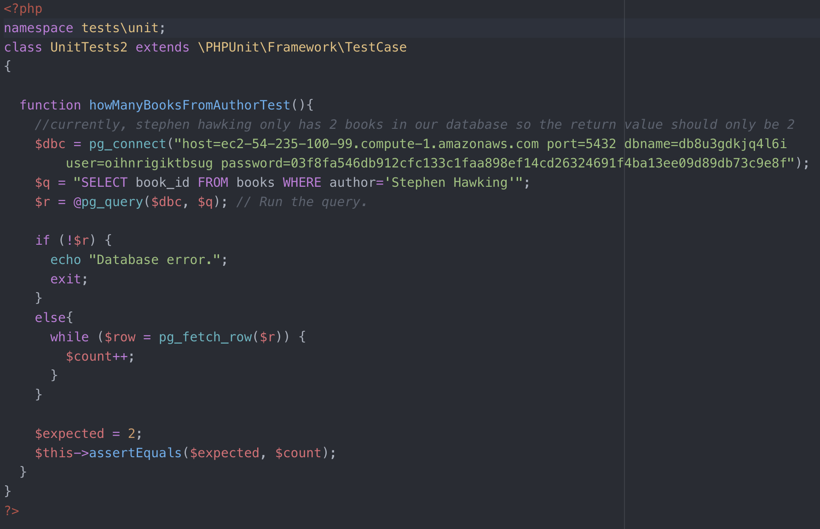
Tester: Jacob Moore
Testing:
Notes:
Ensuring that goals, scope, and product domain are understood by everyone on the Scrum Team as well as possible;

Slide 9
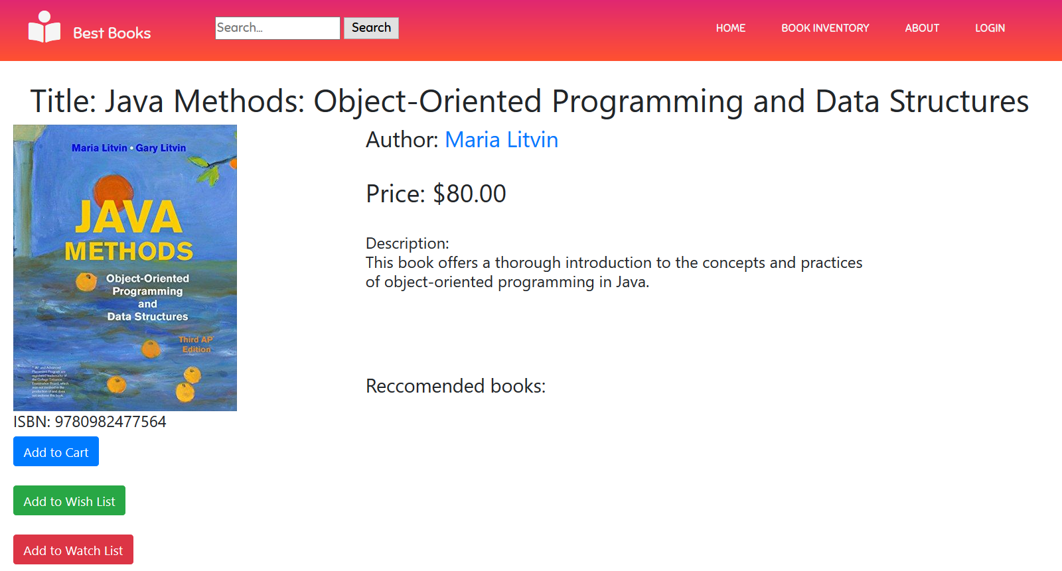
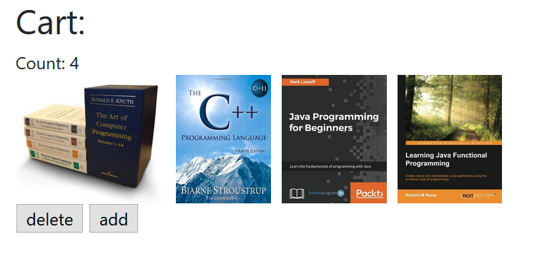
SCM Manager: Reed Inderwiesche
Task: Make Add to Cart button on book page add a book to user’s cart

Slide 10
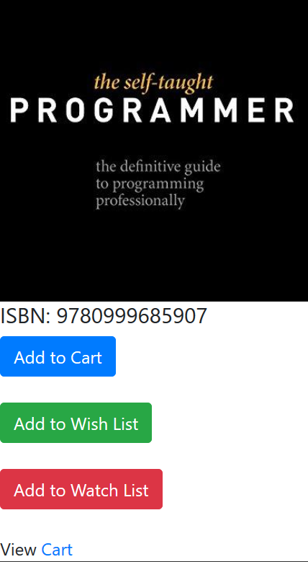
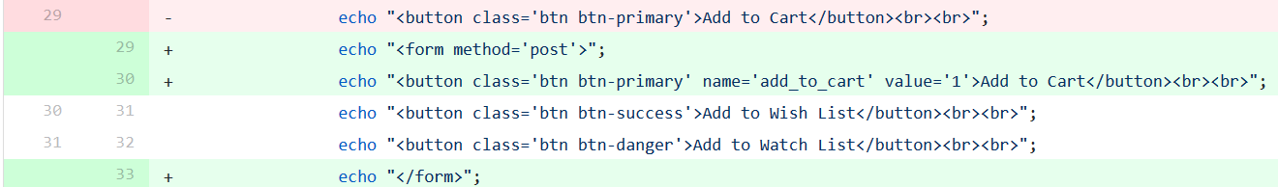
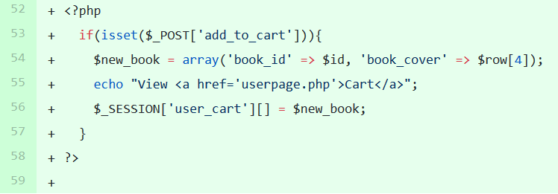
SCM Manager: Reed Inderwiesche
Modified button into a form
When Add to Cart is clicked, book is added to cart and a link to user page is shown

Slide 11
Build Manager: Josh McGuire Database Update
For the sprint my job was to create a column for the categories of the books within the database. For example the book “The Theory of Everything” by Stephen Hawking would be in the genre of science.
To accomplish this task I had to first create a column for the categories which was accomplished by this SQL command: ALTER TABLE books ADD category VARCHAR(30)
Once the column was created to update the category of a book I used the SQL command: UPDATE books SET category = ‘Science’ WHERE book_id = 1;

Slide 12
Build Manager: Josh McGuire Database Connect with SQL Querys
$db_con = pg_connect("host=ec2-54-235-100-99.compute-1.amazonaws.com port=5432 dbname=db8u3gdkjq4l6i user=oihnrigiktbsug password=03f8fa546db912cfc133c1faa898ef14cd26324691f4ba13ee09d89db73c9e8f");
$query = pg_query($db_con, "SELECT COUNT(*) from books");
$query2 = pg_query($db_con, "SELECT COUNT(*) from users");

Slide 13
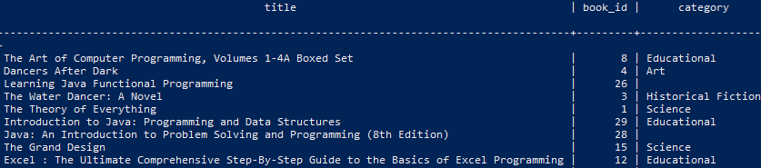
Build Manager: Josh McGuire Database Update

Slide 14
Tester: Zack Sprague
Fixed issue with SQL query not retrieving correct information.
Now shows correct number of users and books in our database.
Added new error message if a user tries to register again with the same email.
Moved most of functions into separate PHP file for ease of testing.
Added more unit tests for previous implementations.

Slide 15
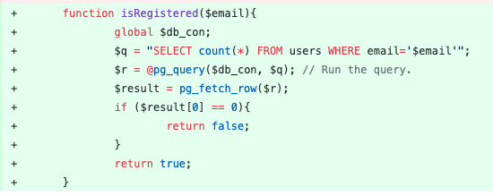
Function to check if user is registered

Slide 16
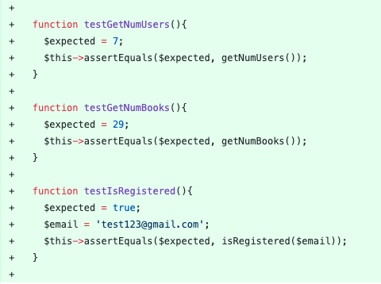
Unit Tests

Slide 17
Configuration Manager: James Craig
Allow the user to sort by author, isbn, or title
Sorts on the results on the page, not the entire database
Not fully functional for title since Title column appears to be not sorted alphabetical

Slide 18
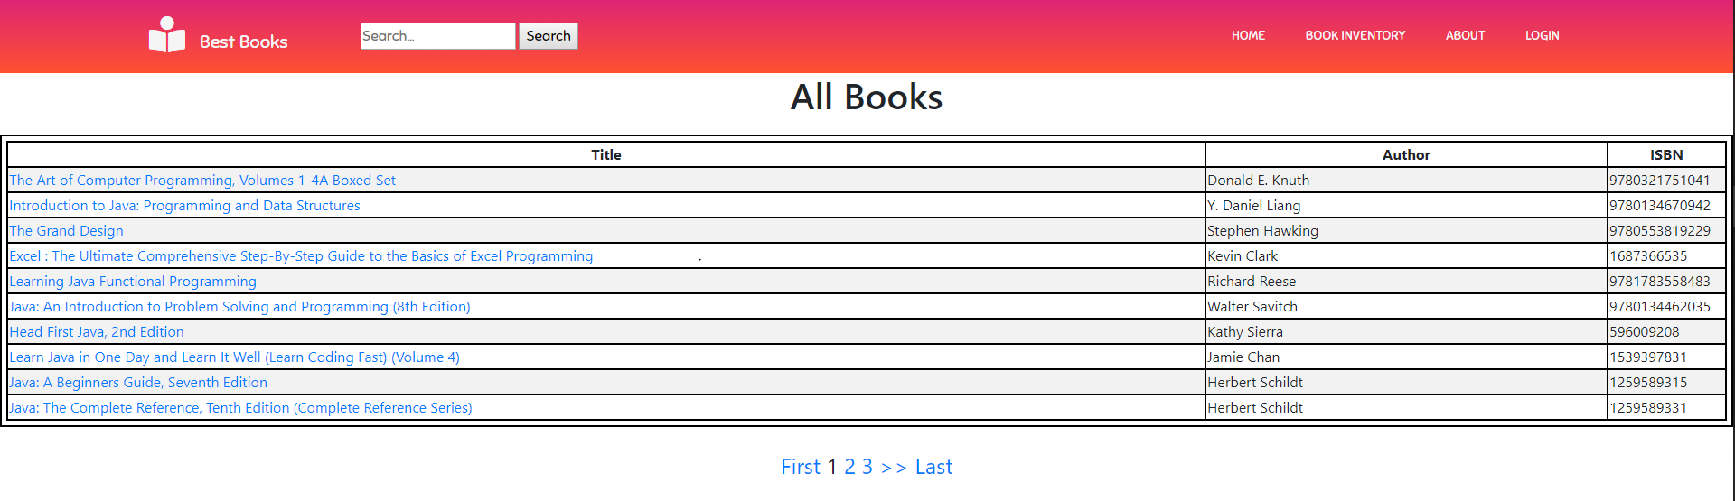
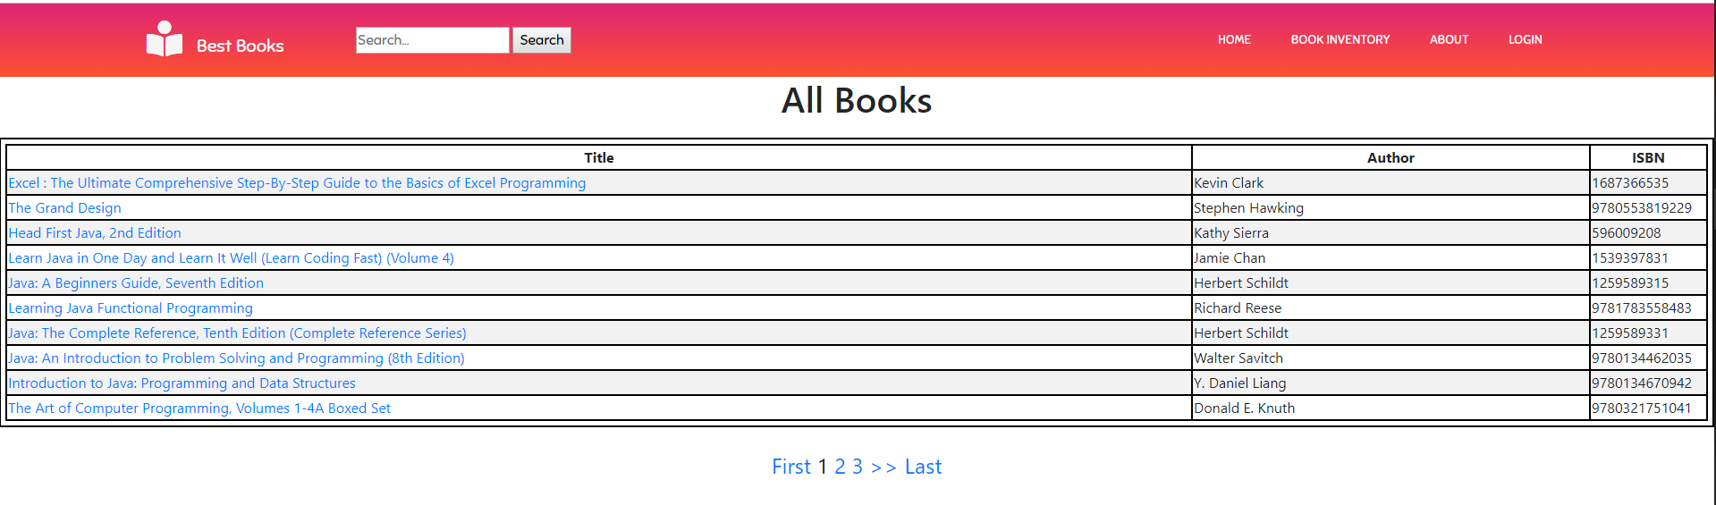

Slide 19
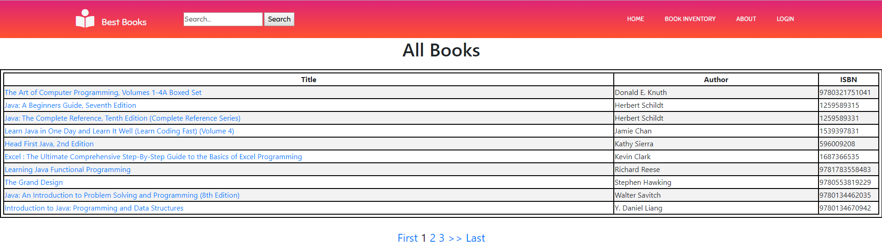
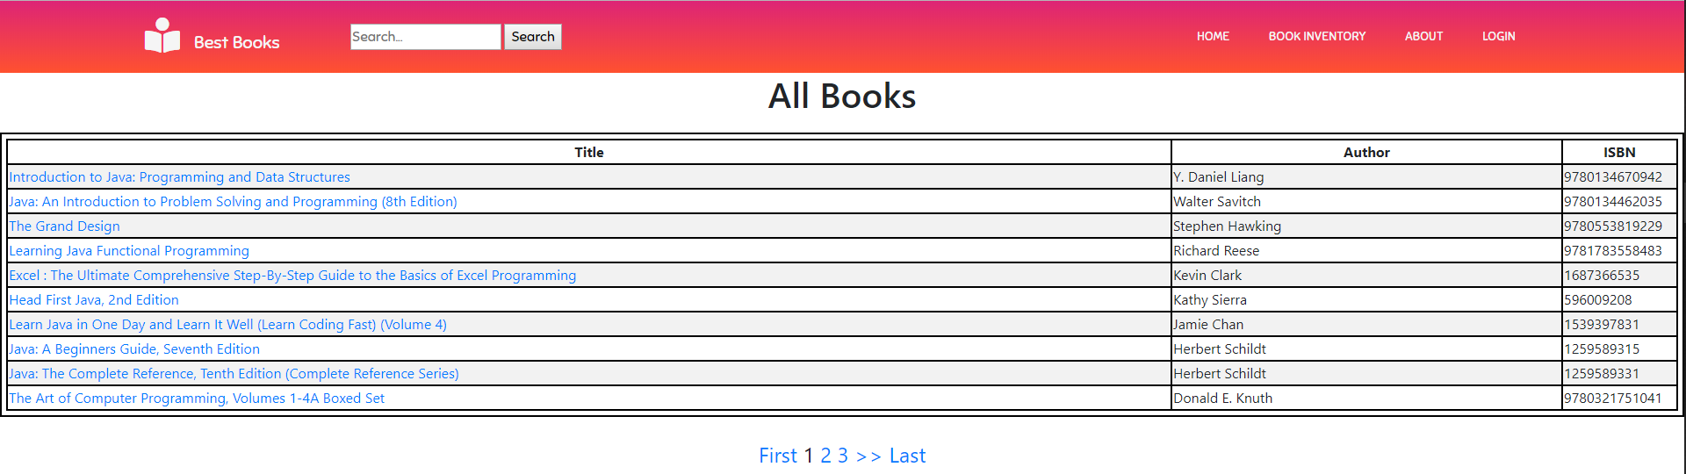

Slide 20
